Slide 1
Applications of Stack
Lecture #
By: Abdul Aleem

Slide 2
Contents
1
Arithmetic Expression
2
Types of Arithmetic Expressions
3
Operator Precedence Table
4
Conversion of Infix to Postfix without using Stack
5
Conversion of Infix to Prefix without using Stack
6 Conversion of Infix to Postfix using Stack
7 Conversion of Infix to Prefix using Stack
8 Evaluation of Postfix Expression using Stack

Slide 3
Arithmetic Expressions
An arithmetic expression consists of some operators (+, -, *, /,etc) and some operands (variables).
Example:- a + b
a, b :- operands or variables on which operation is going to be performed.
+ :- operator denoting the type of operation going to happen, which is, in this case is Addition(+).

Slide 4
Types of Arithmetic Expressions
Infix: operator is placed in between the operands. Examples:- a+b, a-b, a*b, a/b.
Postfix: operator is placed after the operands. Examples:- ab+, ab-, ab*, ab/.
Prefix: operator is placed before the operands. Examples:- +ab, -ab, *ab, /ab.

Slide 5
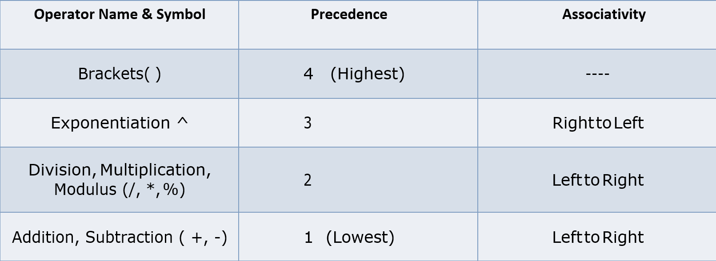
Operator Precedence Table

Slide 6
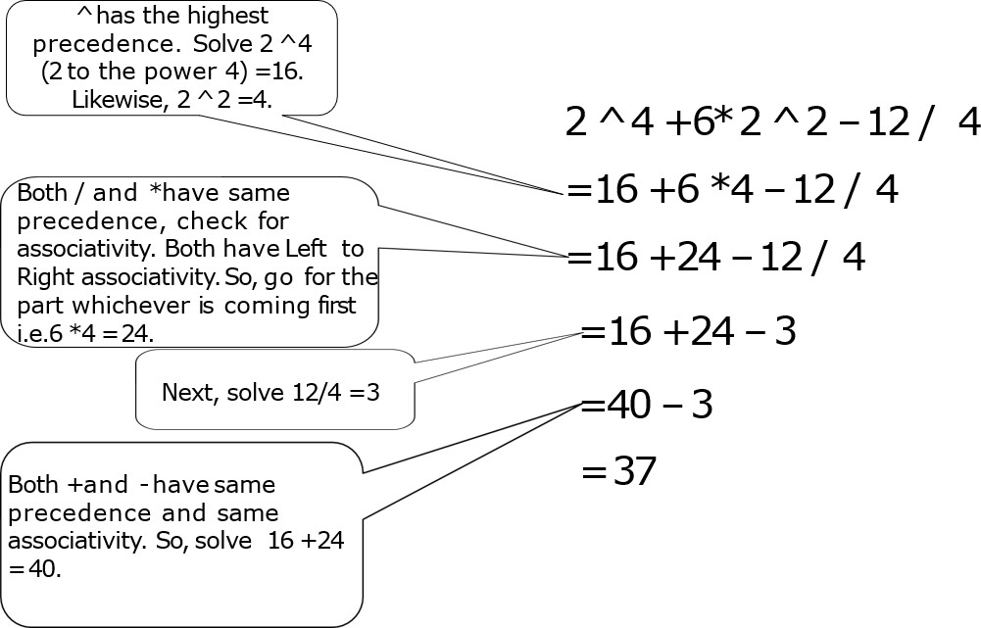
Example

Slide 7
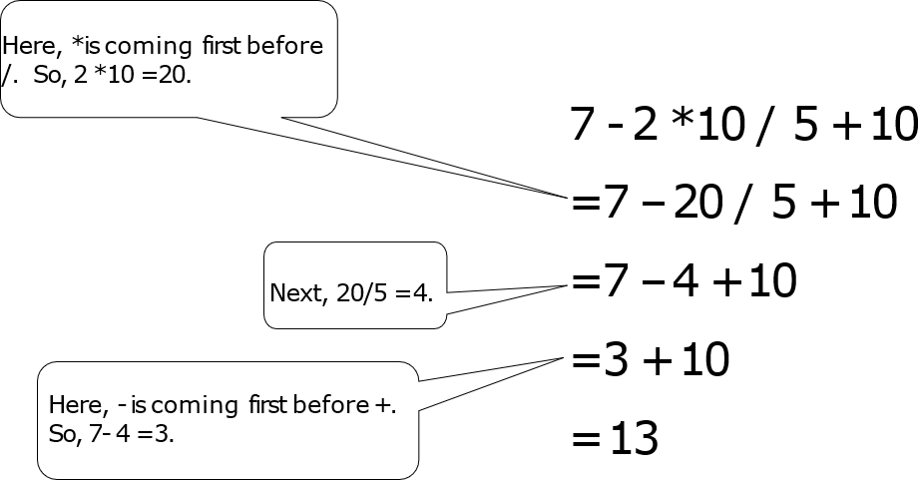
Example

Slide 8
Conversion of Arithmetic Expressions
Conversion of Infix to Postfix.
Conversion of Infix to Prefix
The conversion of these expressions can be done by:
Using stack.
without using stack.

Slide 9
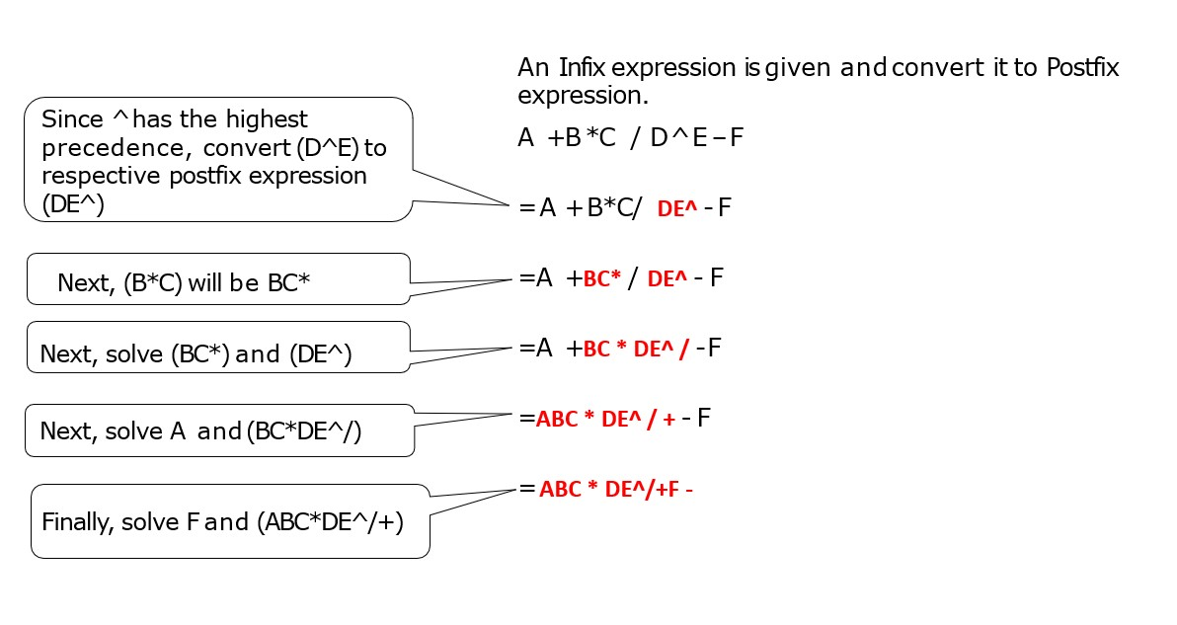
Conversion of Infix to Postfix without using Stack

Slide 10
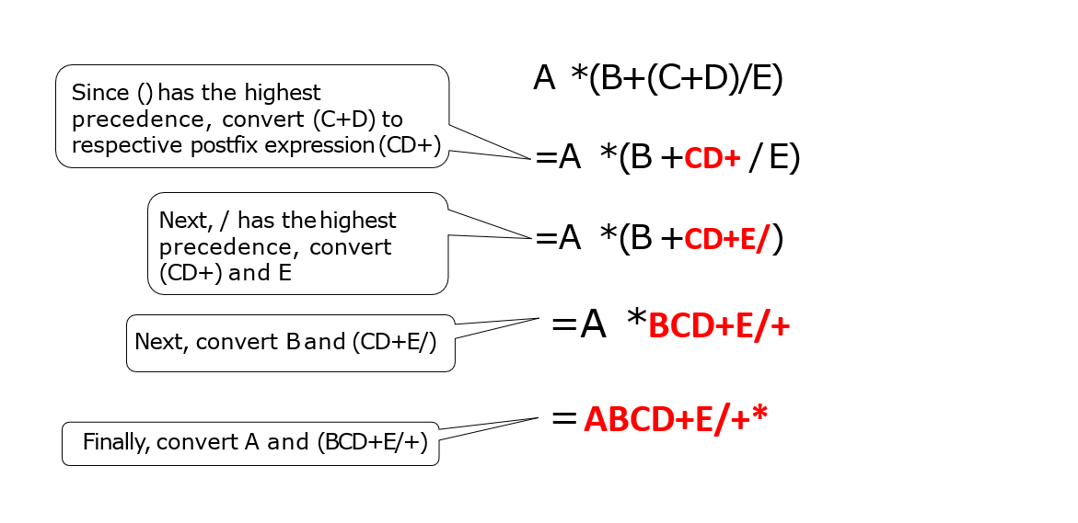
Conversion of Infix to Postfix without using Stack

Slide 11
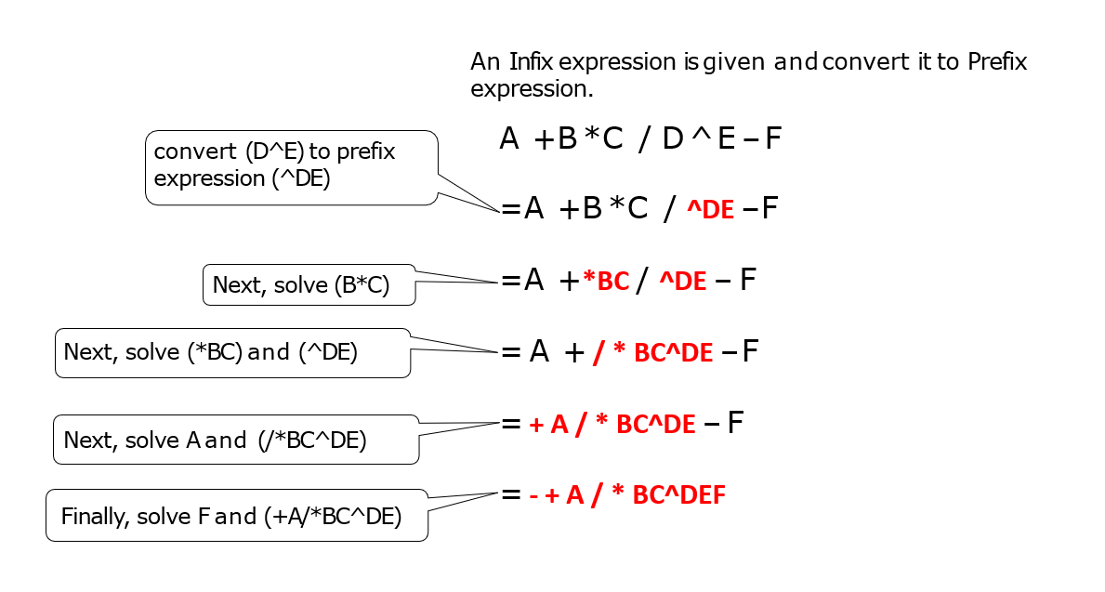
Conversion of Infix to Prefix without using Stack

Slide 12
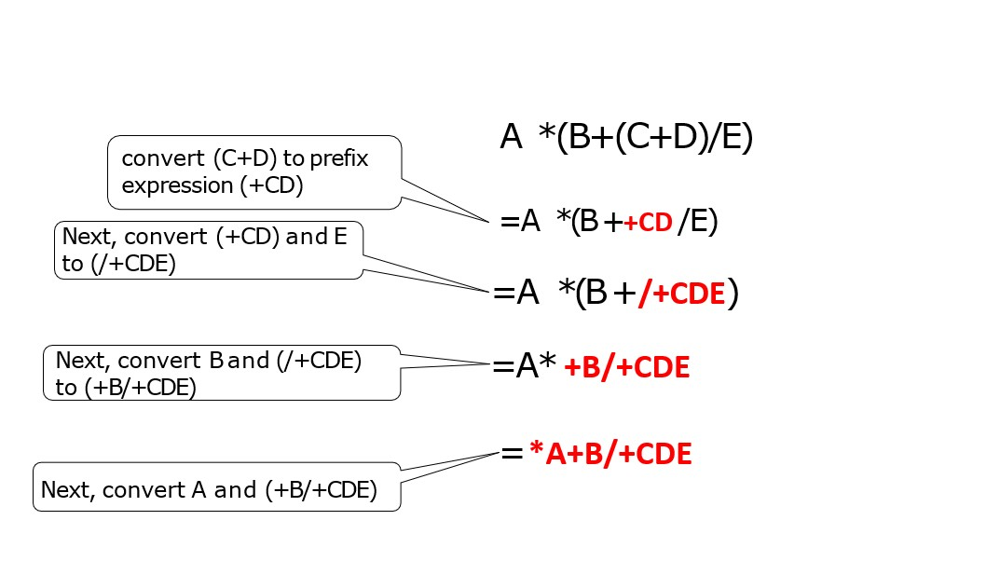
Conversion of Infix to Prefix without using Stack

Slide 13
Conversion of Infix to Postfix using Stack
Scan the infix expression from Left to Right.
If the scanned symbol is an operand, then write it in the Output section.
If the scanned symbol is an operator, then consider these below scenario:
If the stack is empty or contains a “(” , then push the scanned operator in the Stack.
If the scanned symbol has higher precedence than the top, then push the scanned operator in the stack.
If the scanned symbol has lower or same priority than the top, then pop the operators from the stack. After that, push the scanned operator in the stack.
If the scanned symbol is an ‘(‘, push it to the stack.
If the scanned symbol is “)”, then pop the elements from the stack until a “(“ is encountered and discard both the parentheses.

Slide 14
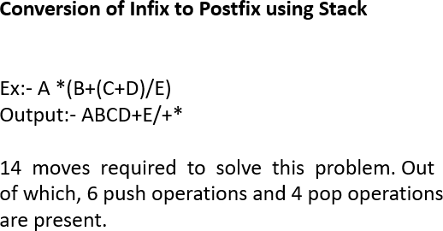
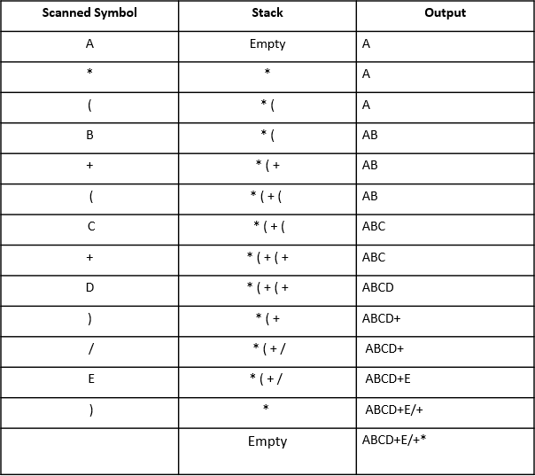
Conversion of Infix to Postfix using Stack

Slide 15
Conversion of Infix to Prefix using Stack
Reverse the infix expression. Note that while reversing each ‘(‘ will become ‘)’ and each ‘)’ becomes ‘(‘.
Obtain the postfix expression of the modified expression.
Reverse the postfix expression to get the desired prefix expression.

Slide 16
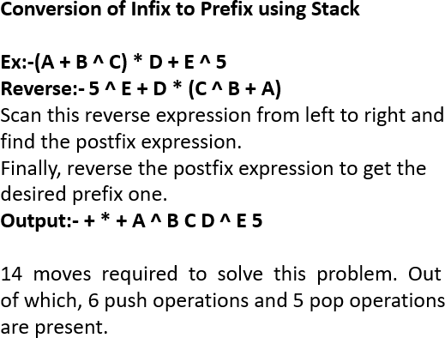
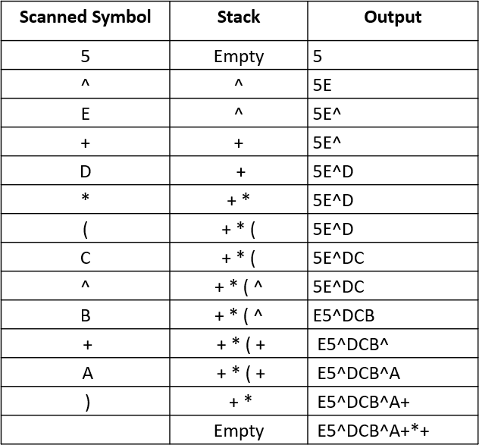
Conversion of Infix to Prefix using Stack

Slide 17
Evaluation of Postfix Expression using Stack
Create a stack to store only the operands (or values).
Scan the given expression from left to right.
If the scanned element is an operand, push it into the stack.
If the scanned element is an operator, pop the top two operands from stack. Eval- uate the operation and push the result back to the stack.
When the expression is ended, the number in the stack is the final answer.
Note:- Let’s assume the top operand is A and next-top operand is B and the operator is /. So, always evaluate the operation like B / A. Similarly, if the operator is *, the operation will be B * A. For -, the operation will be B – A. For +, the operation will be B + A.

Slide 18
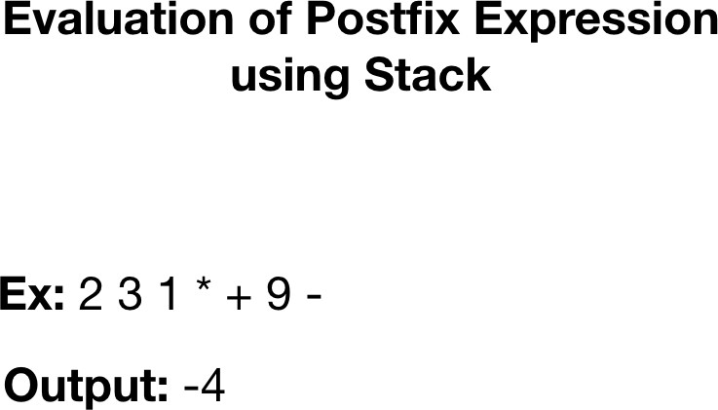
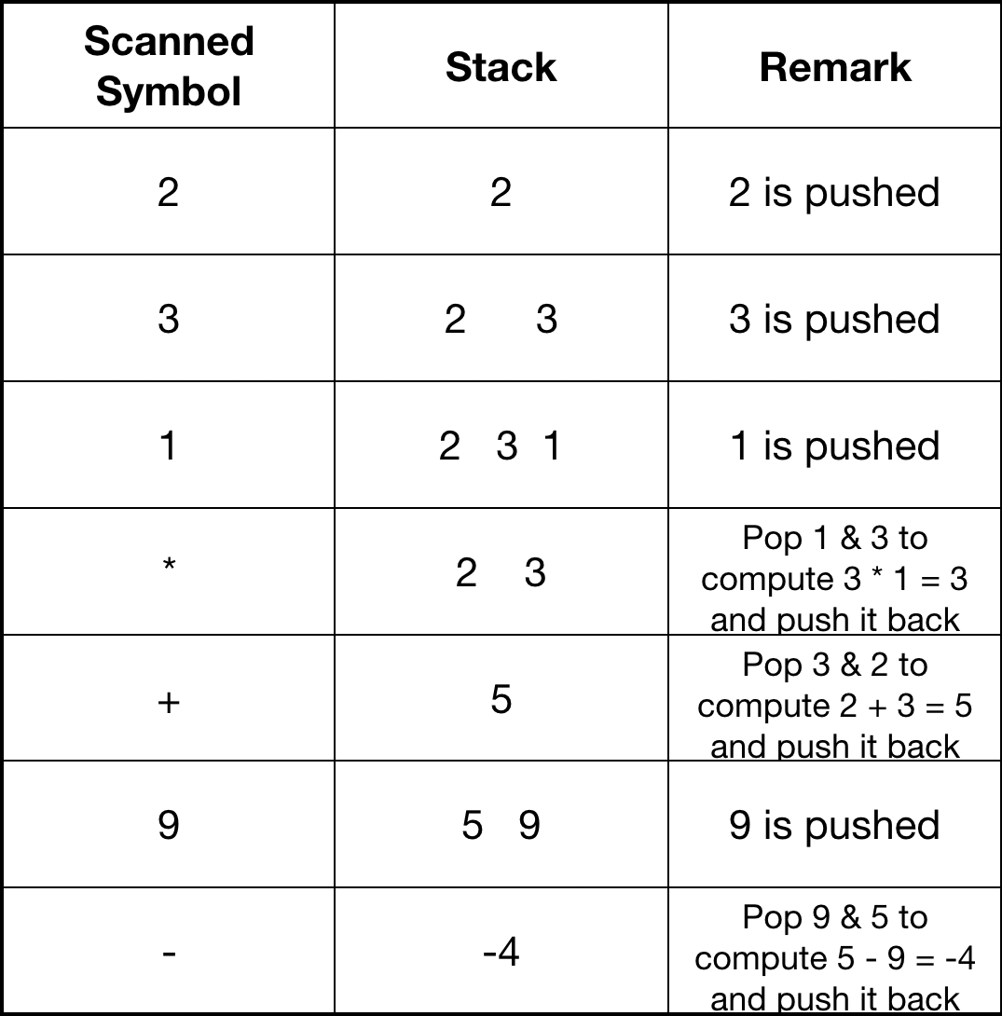
Evaluation of Postfix Expression using Stack

Slide 19
Practice Questions
Infix to Prefix and Postfix expression without using stack
((A+B)*(C+E))
((A*(B*(C+D)+E)+F))
((A + B)*(C–D)+E)/(F+G)
Infix to Prefix and Postfix expression using stack A+B*C/D-E
(A+B*(C-D))/E A/B0C-D

Slide 20
[1] Goodrich and Tamassia ‘Data Structures and Algorithms in java ’, Wiley, India.
Reference

